Slide 1
Alexander Brenner
Austria

Slide 2
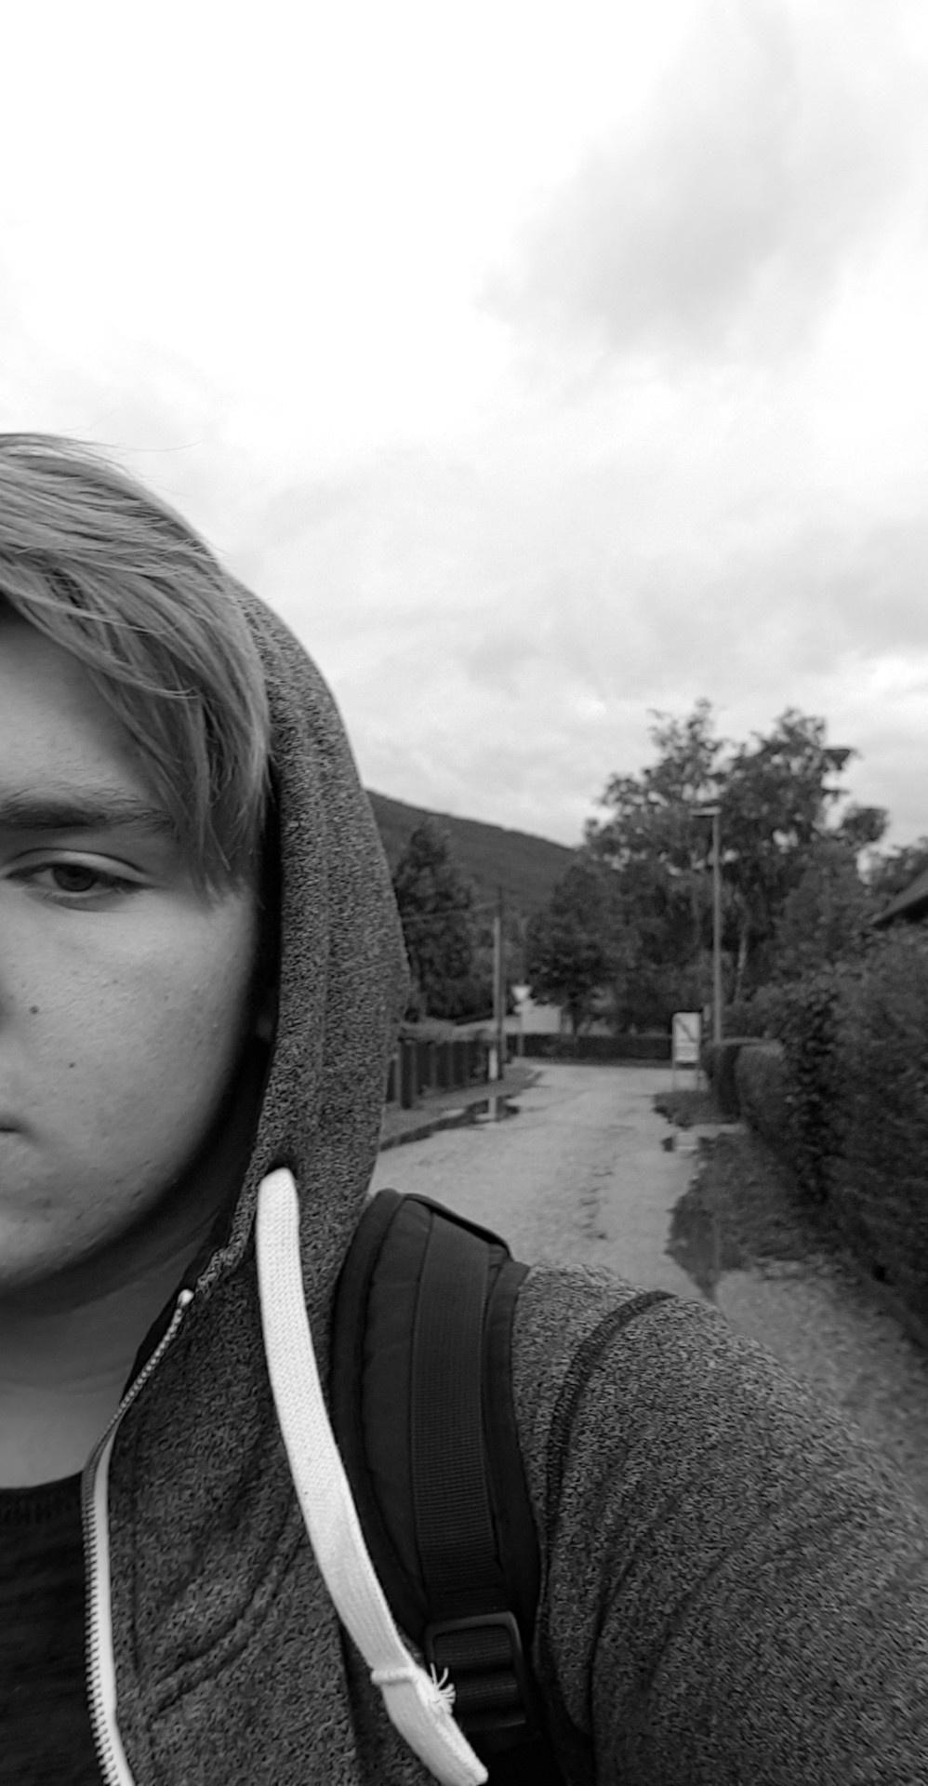
Characteristics
First name: Alexander
Last name: Brenner
Age: 15
School: HTL Wiener Neustadt (Informatics)
Hobbies: programming & soccer
Hometown: Gloggnitz, Lower Austria
Nationality: Austria

Slide 3
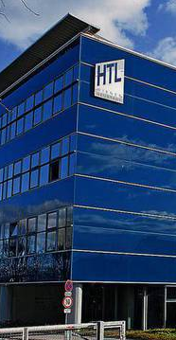

My school
„HTL“ = Higher Technical Institute (Höhere technische Lehranstalt)

Slide 4

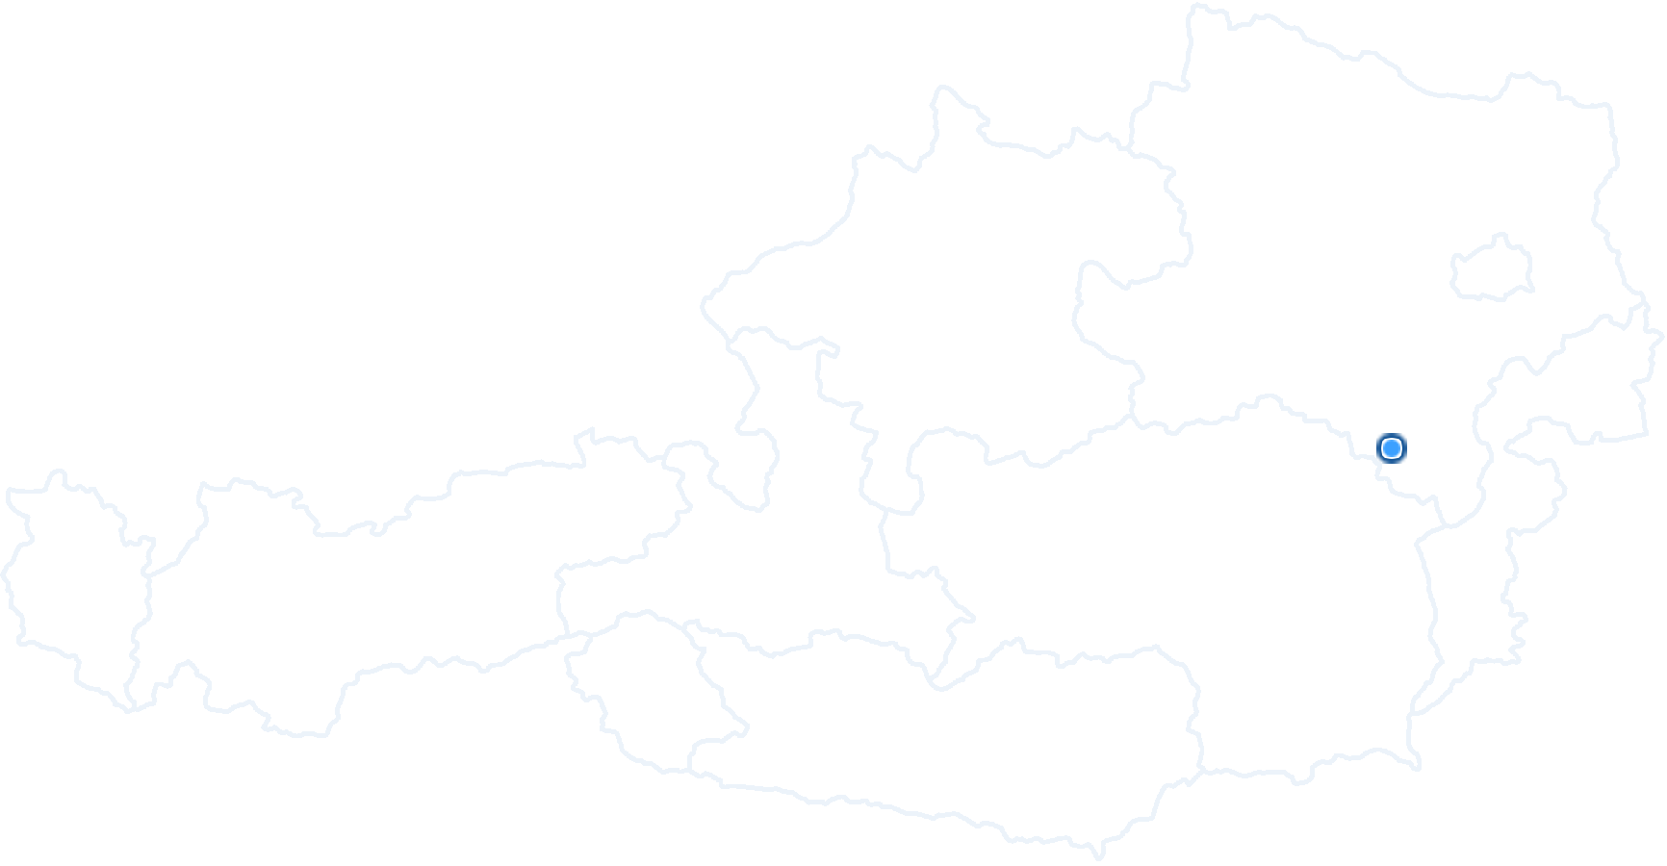
Where I live…
Gloggnitz
Population: 6.022
Federal state: Lower Austria

Slide 5

My computer history
I started working respectively playing with computers at the age of five.
I wrote my first Python-Script at the age of fourteen.
Currently I‘m learning the programming language C++.

Slide 6

Some claims which motivate me
“Live every day as it would be the last one.”
“Together we achieve more”
“There is only one success. Live your life according to your own imaginations“

Slide 7
Thanks for watching
I hope we will have a good time together!

